Slide 1

L I F E EXPECTANCY
BY Guna Seelan C

Slide 2
INTRODUCTION
This dataset provides a comprehensive view of global health indicators across multiple countries and years, with a focus on life expectancy and its influencing factors. It includes both developing and developed nations, allowing comparative analysis of health outcomes and socio-economic conditions

Slide 3
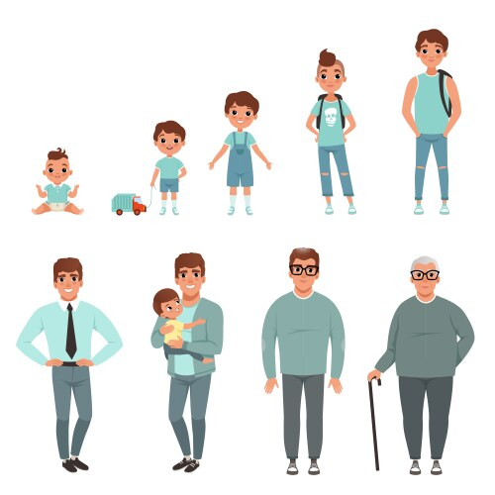
AIM OF THE PROJECT
To study factors that affect life expectancy in different countries
To compare life expectancy between developed and developing nations
To find trends in life expectancy over the years (2000–2015)
To check how health spending and immunization impact life expectancy
To build a model that can predict life expectancy using other variables
To give useful suggestions for improving public health policies

Slide 4
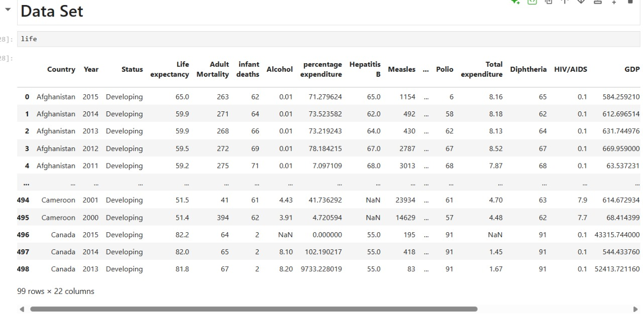
DATA OVERVIEW
5

Slide 5
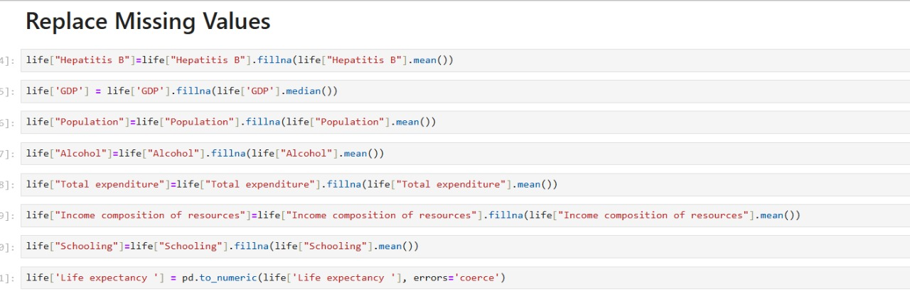
DATA CLEANING
Missing Value Handling
Identify columns with missing values (e.g., GDP, Population, Schooling).
Use appropriate imputation:
Numerical columns: Fill with mean/median or use interpolation.
Categorical columns: Fill with mode or "Unknown".
Outlier Detection
Check for extreme values in Life_expectancy, Adult_Mortality, Alcohol, etc.
Use boxplots or z-score methods to flag outliers.
Data Type Conversion
Convert columns like Year to integer.
Ensure GDP, Population, Alcohol, etc., are floats.
Convert Status to categorical type.

Slide 6
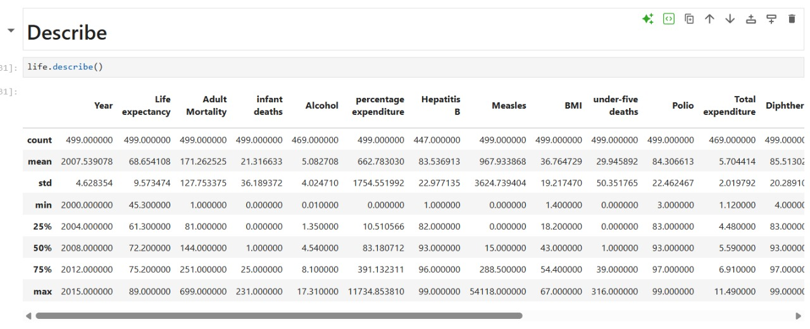
DATA D E S C R I PT I V E

Slide 7
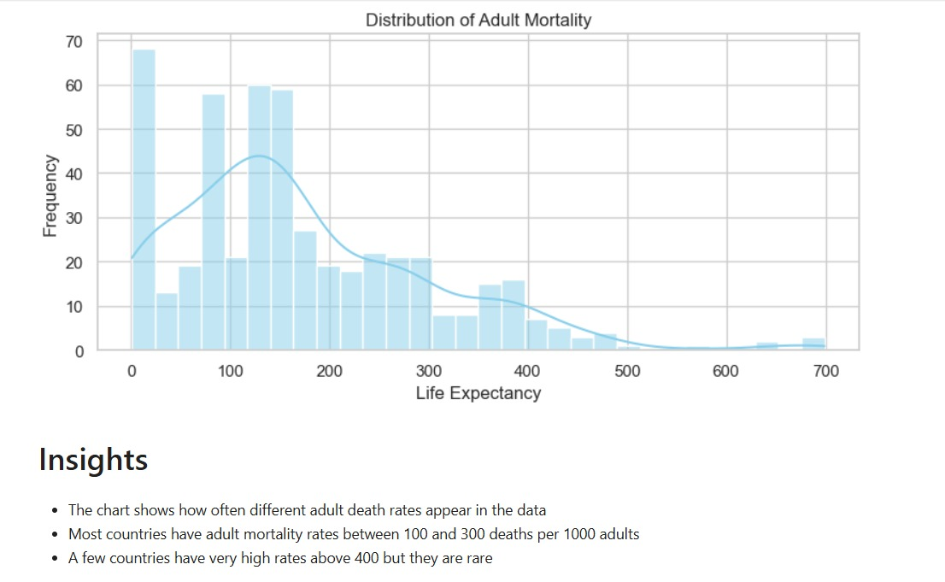
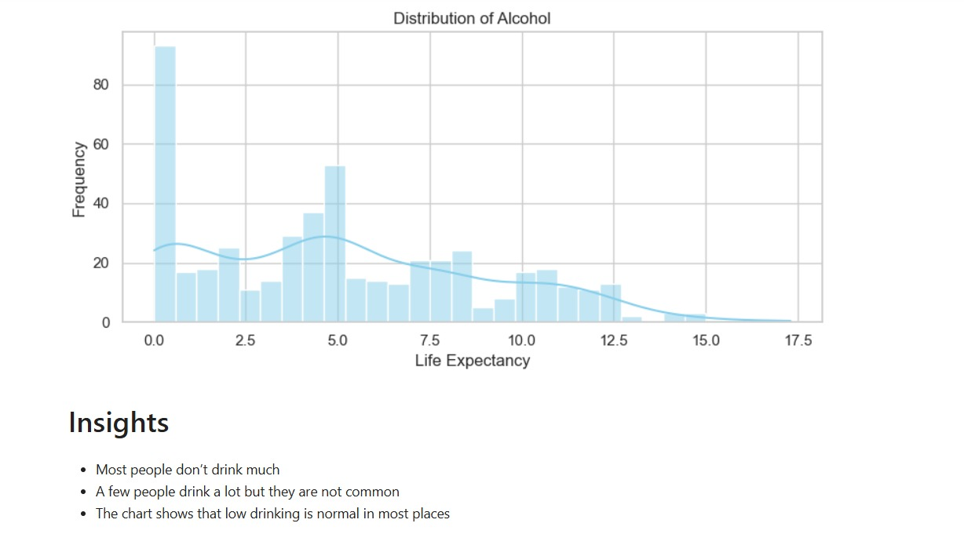
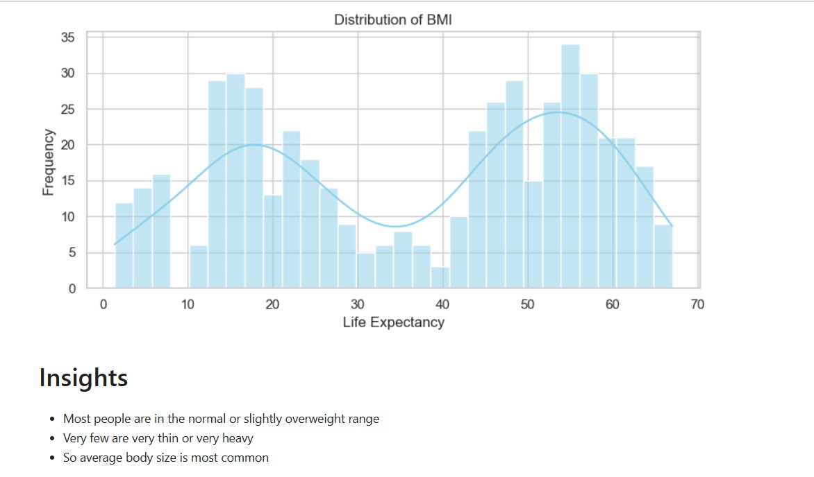
UNIVARIATE ANALYSIS
Histogram plot for Distribution of BMI
Histogram Plot for Distribution of Adult Mortality
Histogram Plot for Distribution of Alcohol
.
2

Slide 8
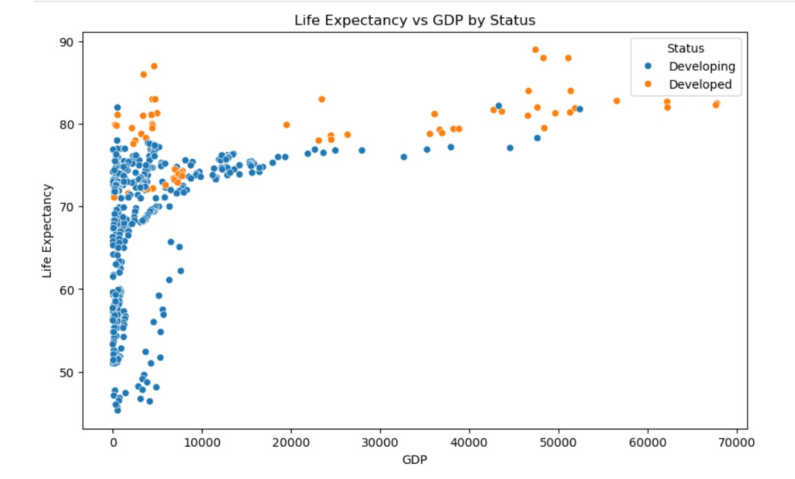
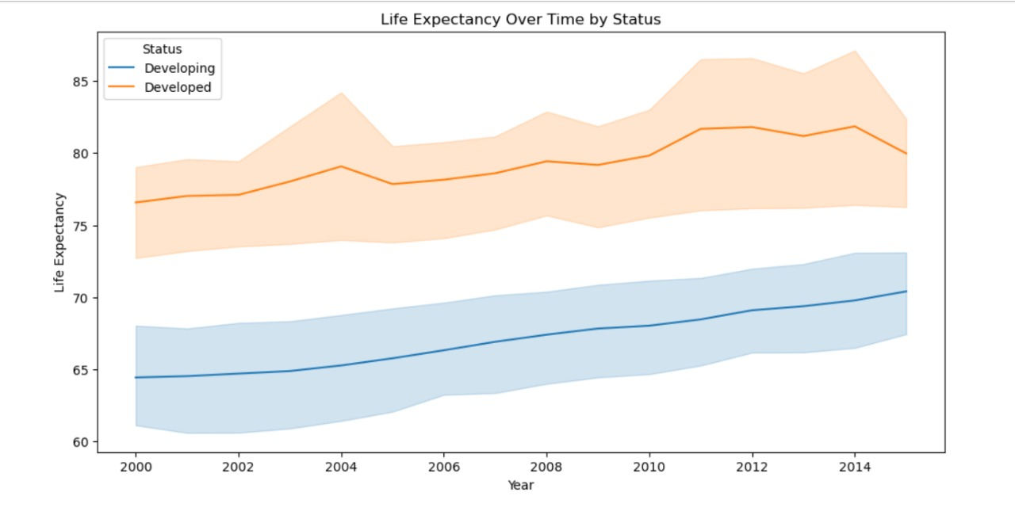
BIVARIATE ANALYSIS
Insights-
Each dot is a country in a specific year.
Left to right shows how rich the country is GDP.
Bottom to top shows how long people live (Life Expectancy).
Color tells you if the country is Developed or Developing.
Insights-
People in developed countries live longer than those in developing countries.
Over the years (2000 to 2015), life expectancy is going up for both groups.
The orange line (developed) is always higher than the blue line (developing), meaning better health or living conditions.
The lines are getting higher slowly
)

Slide 9
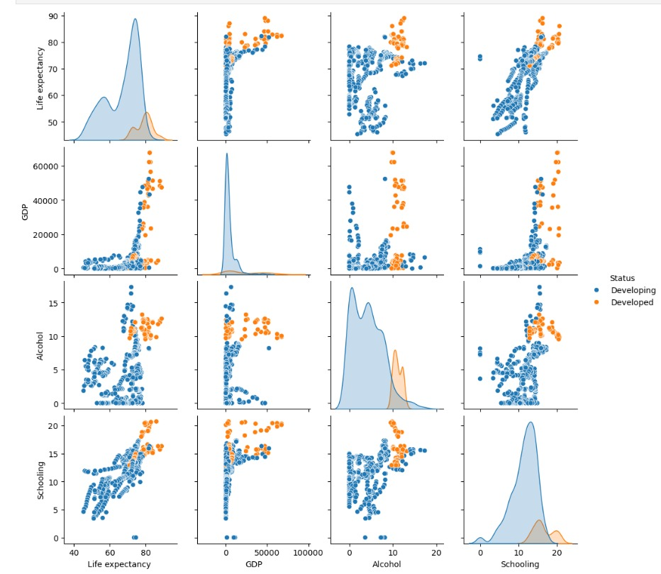
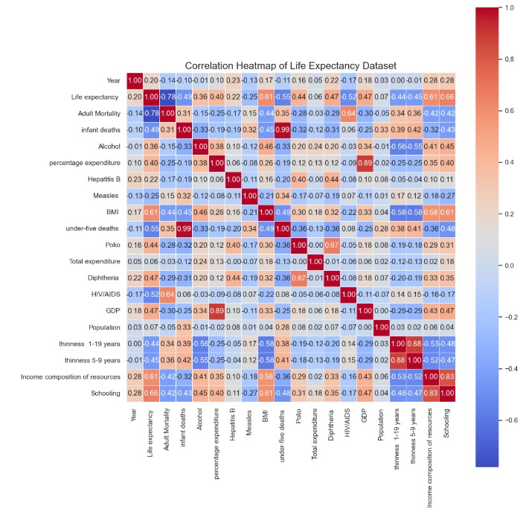
MULTIVARIATE ANALYSIS
Insights-
The chart shows how things like money, health, and education are linked.
Each dot is a country and the color shows if it is developed or developing country.
Rich countries usually live longer and go to school more- You can see how one thing affects another
Insights-
Schooling: More years in school - longer life-
Income Composition of Resources: Better income distribution better health.
GDP: Richer countries tend to live longer
Diphtheria & Polio Coverage: More vaccinations higher life expectancy
Total Health Expenditure: More spending_ better outcomes.

Slide 10
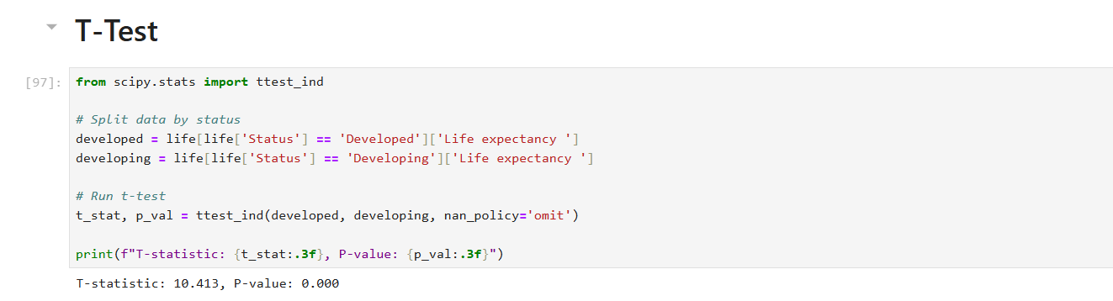
Hypothesis Testing

Slide 11
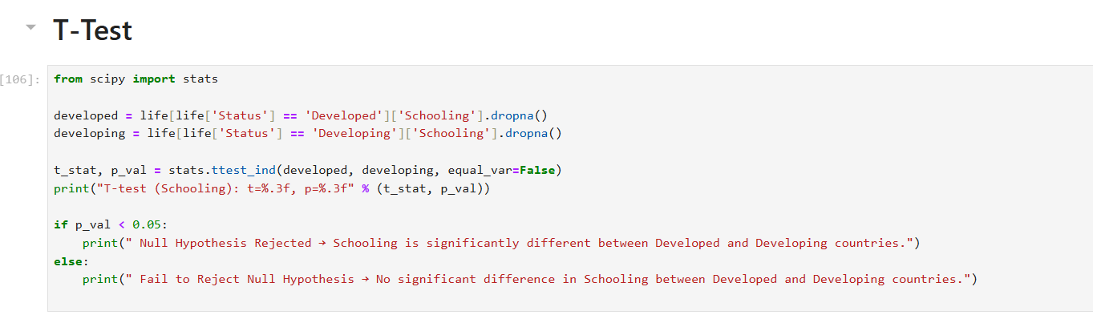
Hypothesis Testing

Slide 12
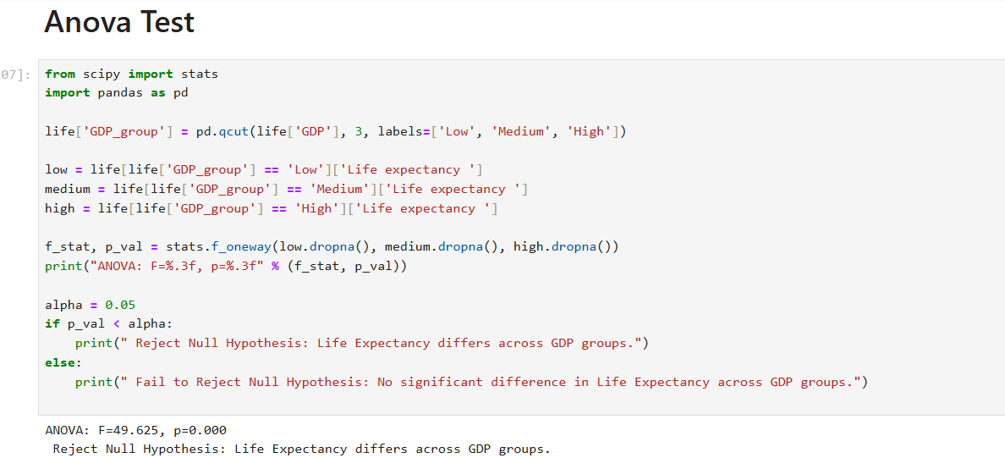
Hypothesis Testing

Slide 13
THANK YOU

